Slide 1
Classification of Tools for Cyber Operations

Slide 2
Logical Tools
Logical tools are the weapons that we likely envision when discussing cyber warfare.
These are the set of tools that is used to conduct reconnaissance, scout out the networks and systems of our opponents, and attack the various targets we might find.
In April of 2013, the U.S. Air Force officially designated six cyber capabilities as weapons systems:
Air Force Cyberspace Defense
Cyberspace Defense Analysis
Cyberspace Vulnerability Assessment/Hunter
Cyber Command and Control Mission System
Air Force Intranet Control
Cyber Security and Control System
This reflects the changing nature of attitudes regarding cyber warfare as “real” war.

Slide 3
Classification of Tools
Reconnaissance Tools
Exfiltration Tools
Logical Tools
Scanning Tools
Sustainment Tools
Access and Escalation Tools
Assault Tools
Obfuscation Tools

Slide 4
Reconnaissance Tools
Reconnaissance tools are those that we use to gather information.
Usually in a passive state, about the networks and systems that we might plan to take action against in a logical sense.
Such efforts may include gathering information from public websites, looking up Domain Name System (DNS) records, collecting metadata from accessible documents, retrieving very specific information through the use of search engine, or any of a number of other similar activities.
Many such tools match closely with Open Source Intelligence (OSINT) techniques.

Slide 5
Whois
Whois is a tool used to query the globally distributed set of databases that contain the information regarding domain names around the world.
The databases contain information regarding when the domain was registered or last updated, which registrar it was registered with, contact information for the owners of the domain, and the name servers that are used to resolve requests sent to the domain name.
The information displayed next is the result of a command line whois query, a tool often found in Linux and Unix operating systems.
We can also run such queries through a variety of web pages dedicated to such purposes, one of the more common being whois.net.

Slide 6
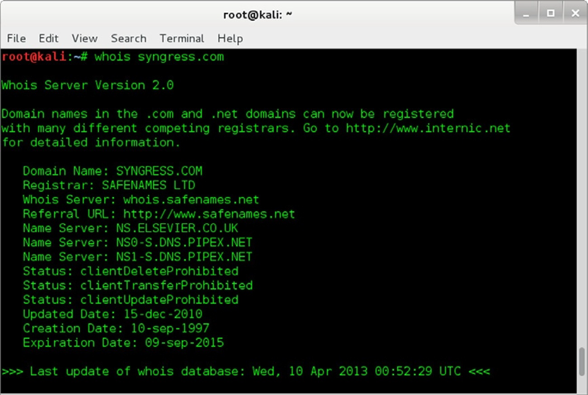
A Whois query from command line

Slide 7
Ns lookup
The DNSs are responsible for fulfilling name resolution requests for clients that are attempting to resolve the domain name to an IP address.
Numerous tools are available to aid us in our quest for DNS information.
We can conduct command line queries in most operating systems by using the nslookup command.
Nslookup will generally return the IP address of the DNS server, which we can then interrogate for additional information.

Slide 8
Ns lookup
In Windows, we can do this with an interactive mode command like:
nslookup
> server [DNS server name or IP]
> set type¼any
> ls -d [domain name]
This will fail to return the information in most cases as DNS servers will not generally perform a zone transfer to an arbitrary requestor on the Internet.
A similar tool to nslookup, called dig, can be found on most Linux systems and is capable of conducting zone transfers where the DNS server in question is willing to cooperate.

Slide 9
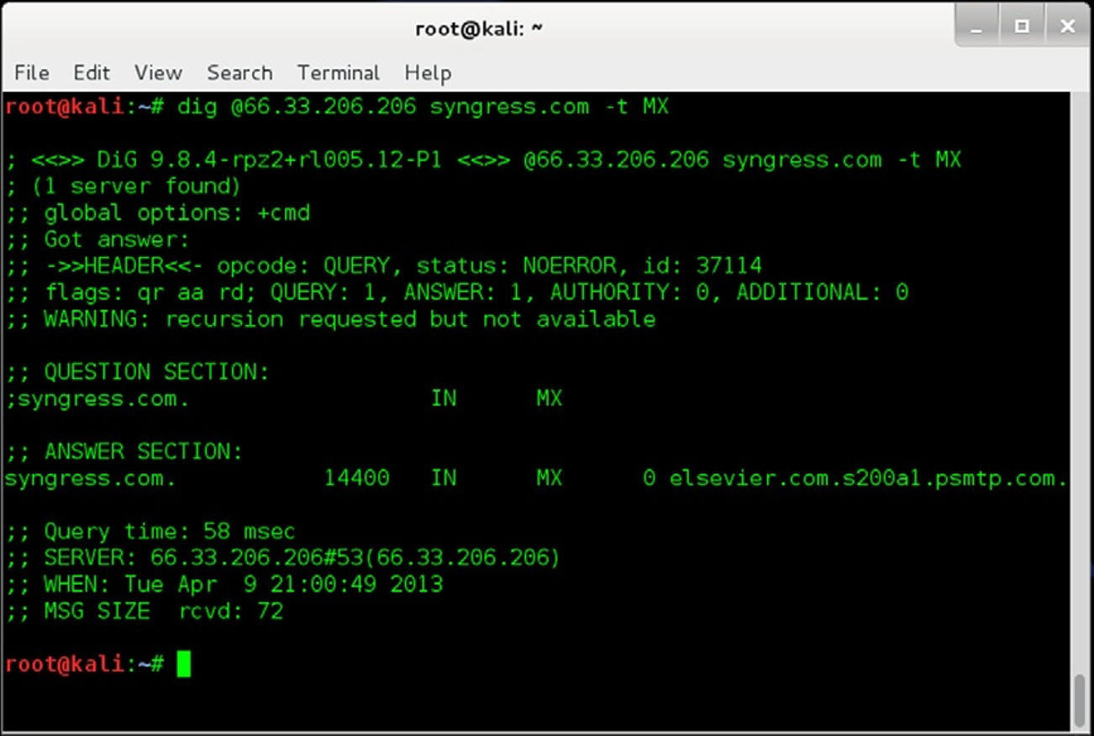
Dig information for Syngress.com

Slide 10
Metagoofil
Metagoofil is an excellent tool for hunting down metadata.
Metagoofil is a script that conducts very directed Google searches.
Once the documents have been located:
they are downloaded and parsed for interesting information in the document metadata;
which is then displayed in html format for easy perusal of the user.

Slide 11
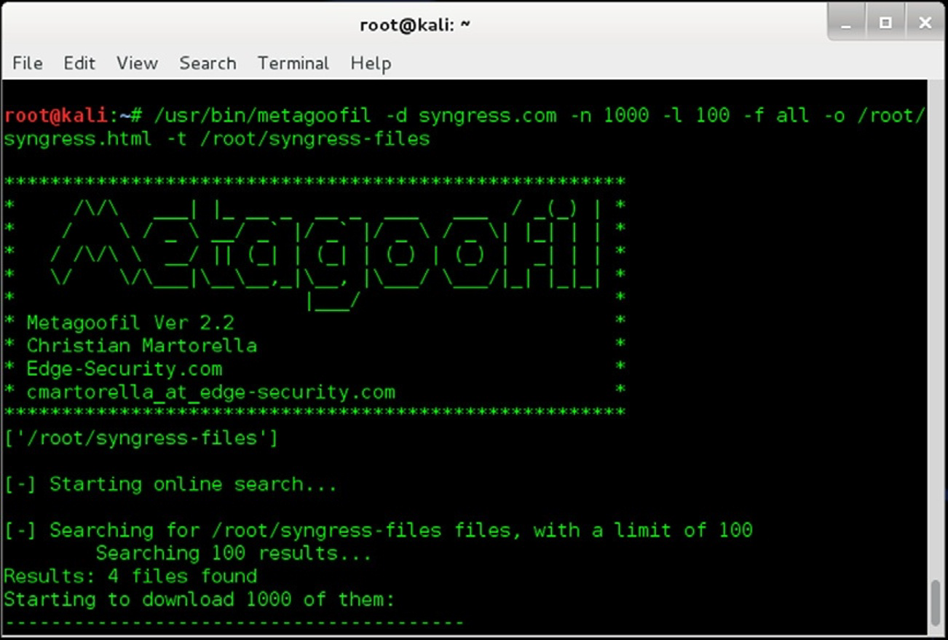
Metagoofil information for Syngress.com

Slide 12
Scanning Tools
Scanning tools are used to find more information about our target environment, the systems within it, and the details of those systems.
With such tools, we can:
run ping sweeps;
run port scans;
grab banners or enumerating users on particular systems.

Slide 13
Wireshark
Wireshark is a data capturing program that "understands" the structure of different networking protocols.
It can parse and display the fields, along with their meanings as specified by different networking protocols.
Wireshark uses pcap to capture packets, so it can only capture packets on the types of networks that pcap supports.
Data can be captured "from the wire" from a live network connection or read from a file of already-captured packets.

Slide 14
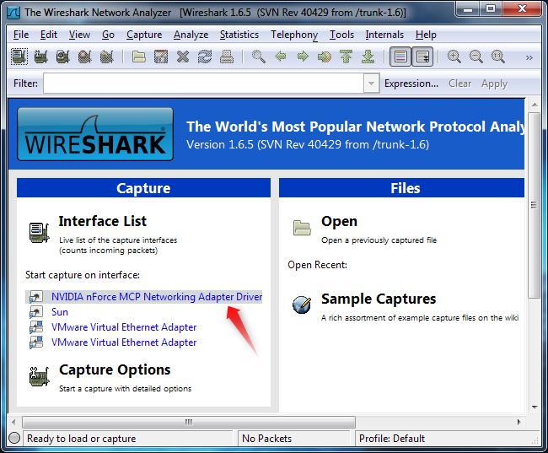
Wireshark Network Analyzer GUI

Slide 15
Wireshark
Captured files can be programmatically edited or converted via command-line switches to the "editcap" program.
Data display can be refined using a display filter.
VoIP calls in the captured traffic can be detected.
If encoded in a compatible encoding, the media flow can even be played.
Wireless connections can also be filtered as long as they transverse the monitored Ethernet.

Slide 16
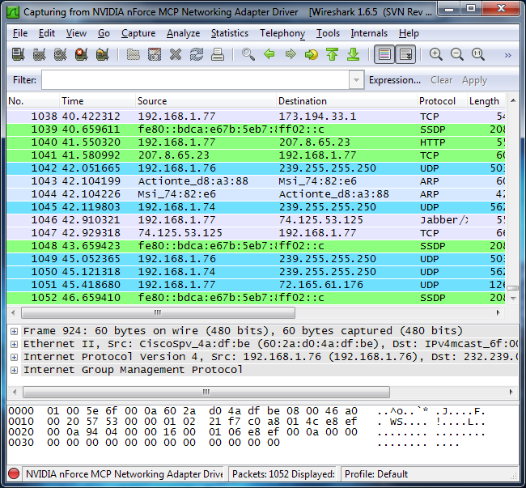
Capturing Packets

Slide 17
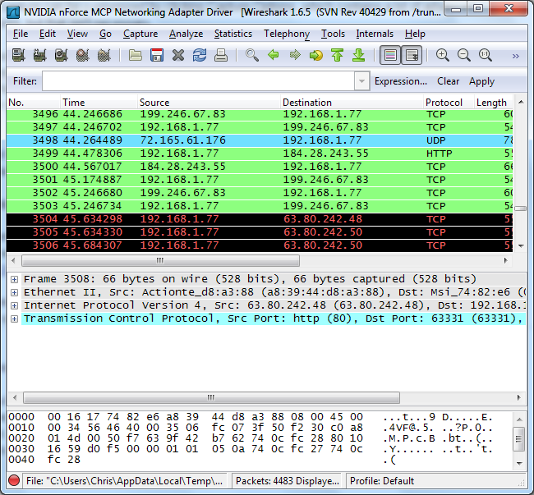
Packets Delivered Out-of Order

Slide 18
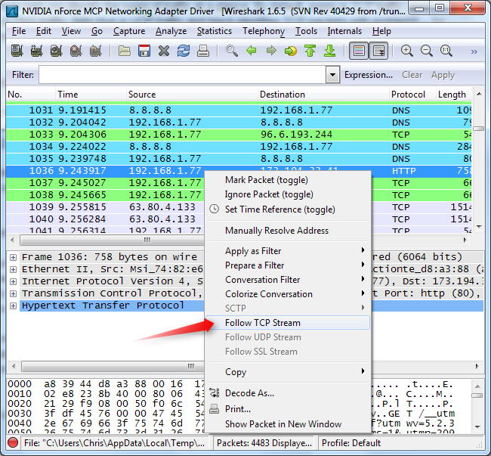
Follow TCP Stream

Slide 19
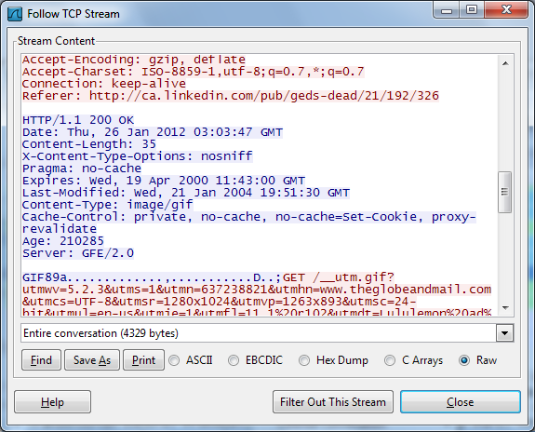
Follow TCP Stream Output

Slide 20
Netcat
Netcat (often abbreviated to nc) is a computer networking utility for reading from and writing to network connections using TCP or UDP.
Netcat is designed to be a dependable back-end that can be used directly or easily driven by other programs and scripts.

Slide 21
Netcat
The original netcat's features include:
Outbound or inbound connections, TCP or UDP, to or from any ports
Full DNS forward/reverse checking, with appropriate warnings
Ability to use any local source port
Ability to use any locally configured network source address
Built-in port-scanning capabilities, with randomization
Built-in loose source-routing capability

Slide 22
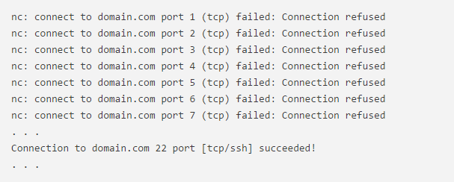
Netcat for Port Scanning
We can scan all ports up to 1000 by issuing this command:
Along with the -z option, we have also specified the -v option to tell netcat to provide more verbose information. The output will look like this:

Slide 23
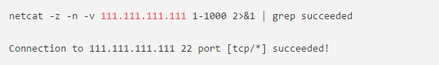
Netcat for Port Scanning
Our scan will go much faster if we know the IP address that we need. We can then use the -nflag to specify that you do not need to resolve the IP address using DNS:
We will redirect standard error to standard output using the 2>&1 bash syntax. We will then filter the results with grep:

Slide 24
tcpdump
tcpdump is a common packet analyzer that runs under the command line.
It allows the user to display TCP/IP and other packets being transmitted or received over a network to which the computer is attached.
Tcpdump works on most Unix-like operating systems: Linux, Solaris, BSD, OS X, HP-UX, Android.
In those systems, tcpdump uses the libpcap library to capture packets.
The port of tcpdump for Windows is called WinDump; it uses WinPcap, the Windows port of libpcap.

Slide 25
Tcpdump Commands
Basic communication: see the basics without many options
tcpdump -nS
A deeper look at the traffic:adds -X for payload but doesn’t grab any more of the packet
tcpdump -nnvvXS
Heavy packet viewing: the final “s” increases the snap length, grabbing the whole packe
tcpdump -nnvvXSs 1514

Slide 26
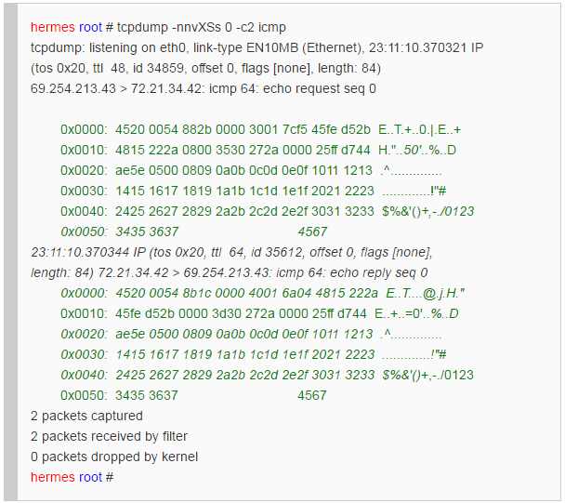
Capture of exactly two (-c2) ICMP packets

Slide 27
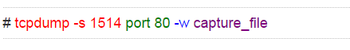
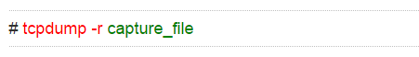
Capturing Files
Capture all Port 80 Traffic to a File:
Read Captured Traffic back into tcpdump:

Slide 28
Nmap
It is principally a port scanner.
It can be used to ping IPs, detect vulnerabilities, fingerprint operating systems, run traceroutes.
Nmap is a free tool and ships with many Linux and Unix operating systems.
In addition to the command line version there are also a variety of GUIs that can be used as a frontend to nmap, including Zenmap which was created by the author of nmap.

Slide 29
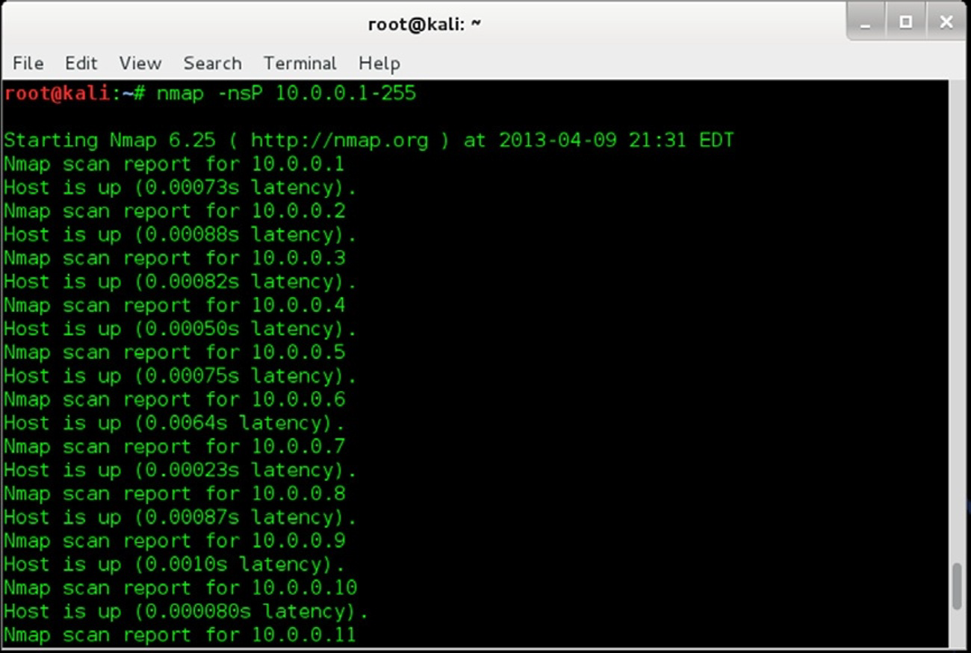
Nmap scan results

Slide 30
Nessus
Nessus is primarily a vulnerability scanning tool.
Nessus classifies vulnerabilities into sets of plugins, with each family of plugins focusing on a particular type of vulnerability.
These families include a variety of different operating systems, databases, protocols, and services.
A complete Nessus scan shows
the machines located;
the current state of completion for the scan of each device;
the number of vulnerabilities in the high, medium, and low categories;
the number of open ports on each device.

Slide 31
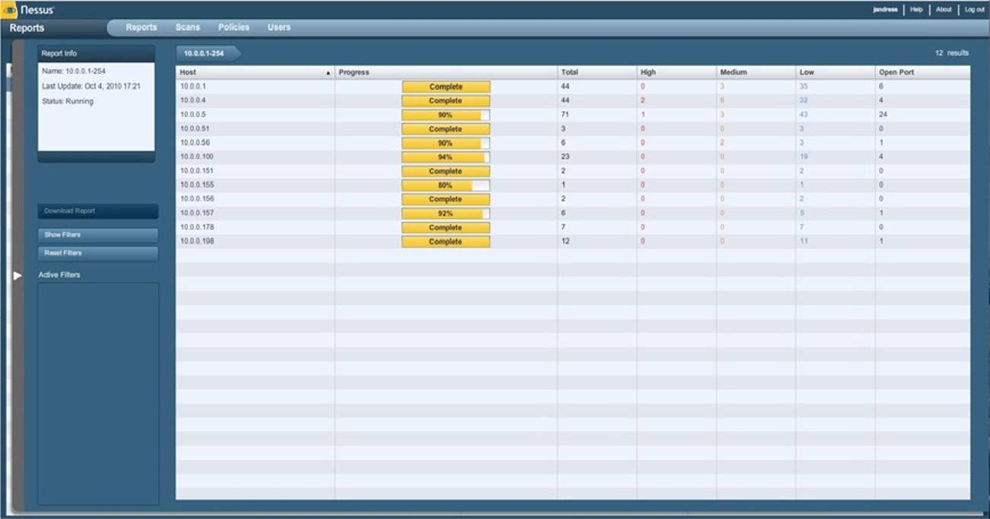
Nessus scan in progress

Slide 32
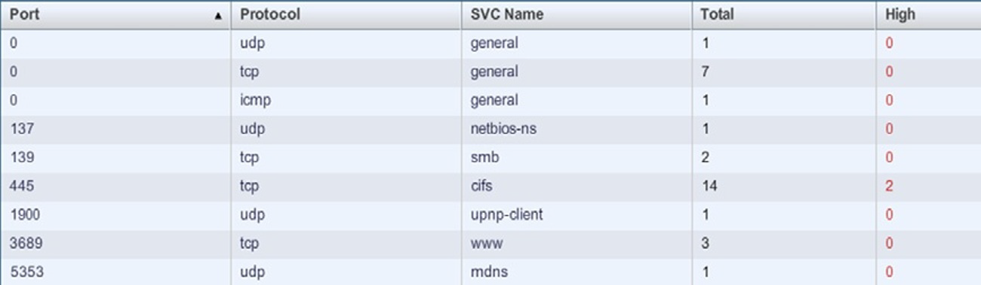
Nessus port scan results

Slide 33
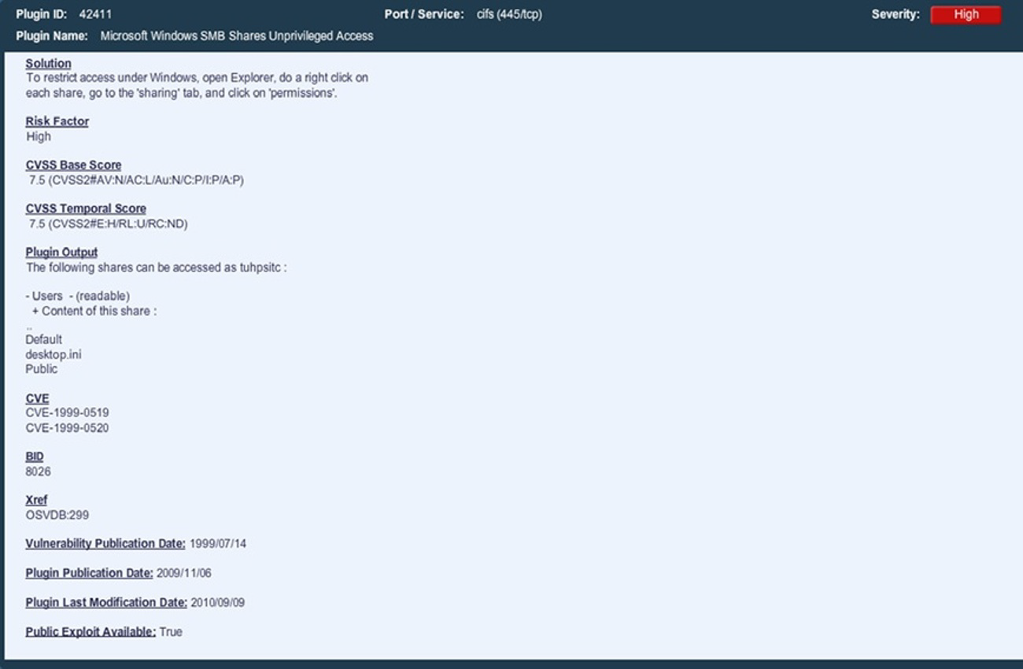
Nessus vulnerability listing

Slide 34
Snort
Snort is an open source IDS (Intrusion detection system) written by Martin Roesch.
Snort can run in 4 modes:
sniffer mode: snort will read the network traffic and print them to the screen.
packet logger mode: snort will record the network traffic on a file
IDS mode: network traffic matching security rules will be recorded.
IPS mode: also known as snort-inline

Slide 35
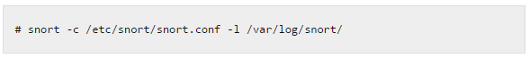
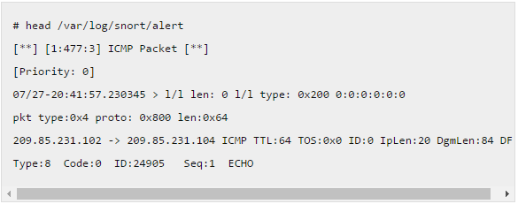
Snort Execution
Pinging some IP from your machine, to check ping rule. Following is the example of a snort alert for this ICMP rule:

Slide 36
Access and Escalation Tools
A great number of the hacking and penetration testing tools are available.
Both open source and commercial.
These are focused on gaining access to systems and escalating our level of privilege once we are able to access the system.

Slide 37
The Metasploit Framework
Framework is primarily intended to be used as a command line tool.
The process of using Framework to attack a system is, in broad strokes:
Collect information about the target system using scanning and vulnerability assessment tools, such as nmap and Nessus
Select an exploit that matches the system based on the collected information
Select a payload to accompany the exploit, often a remote shell
Execute the exploit and payload

Slide 38
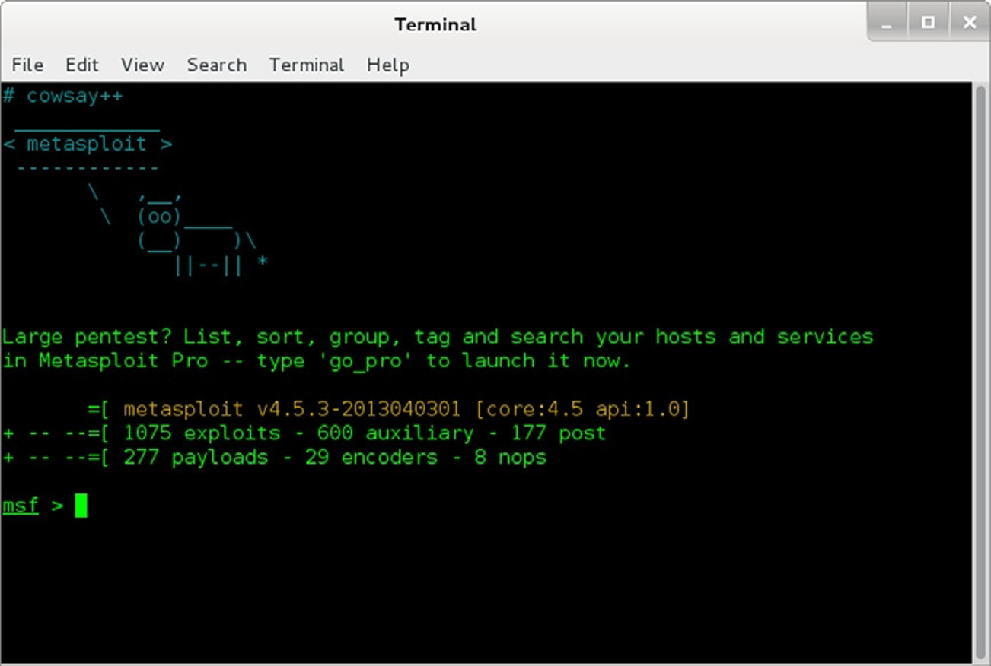
Metasploit Framework

Slide 39
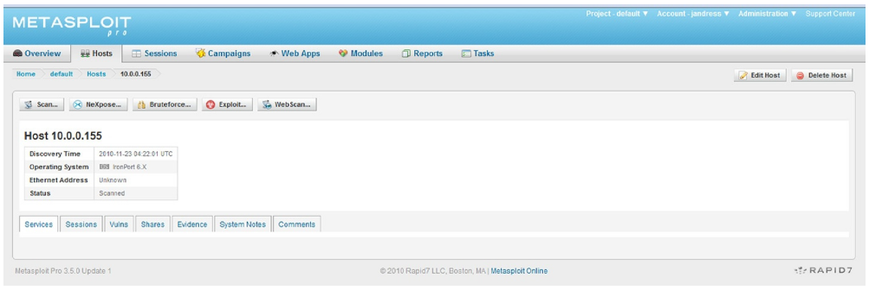
Metasploit Pro GUI

Slide 40
Immunity CANVAS
CANVAS contains a good selection of exploits and payloads (around 300 exploits at the time of this writing).
It tends to be updated very quickly to include some of the newer and more interesting exploits soon after they are publicly released.
CANVAS is developed in Python, and includes both GUI and command line interfaces.
CANVAS also includes some more unique features such as the geolocation and mapping feature, allowing target systems to be displayed on a world map within the interface

Slide 41
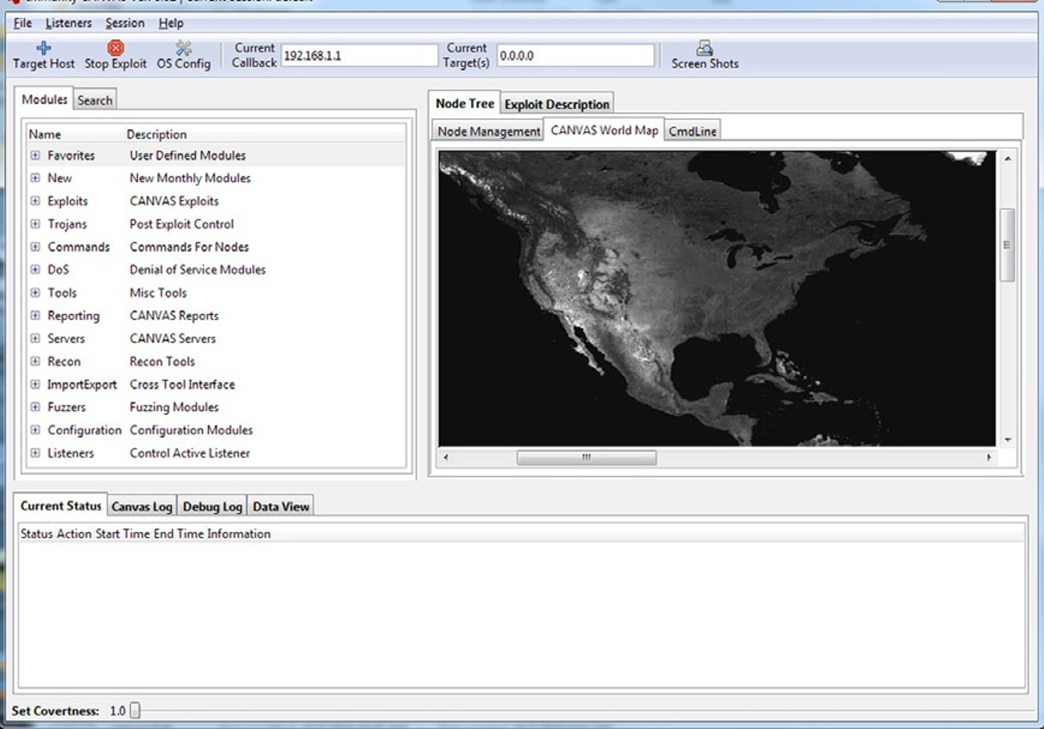
Immunity CANVAS

Slide 42
Cain and Abel
Cain and Abel is a password recovery tool available as free to download from its official website.
It can also be used for easy recovery of passwords from packets captured from a network.
It allows the various type of password cracking tools:
network sniffer,
Brute Force and Dictionary attack,
Voip conversations,
hash decoders,
Arp poisoning,
analyzing routing protocols etc.

Slide 43
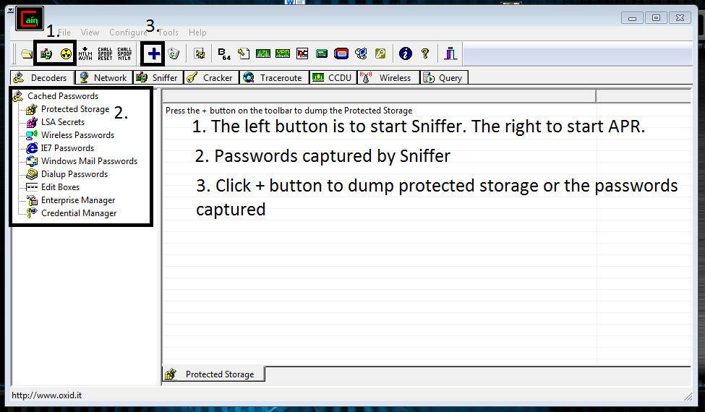
Cain and Abel GUI

Slide 44
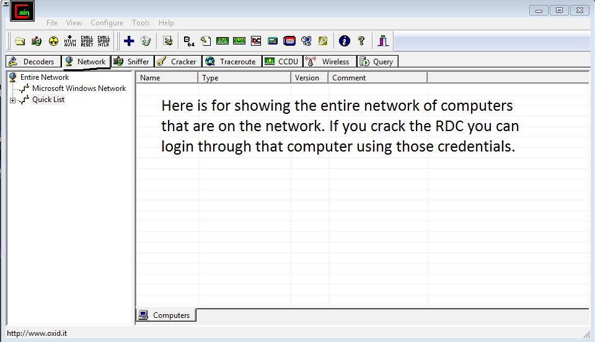
Cain and Abel Networks Tab

Slide 45
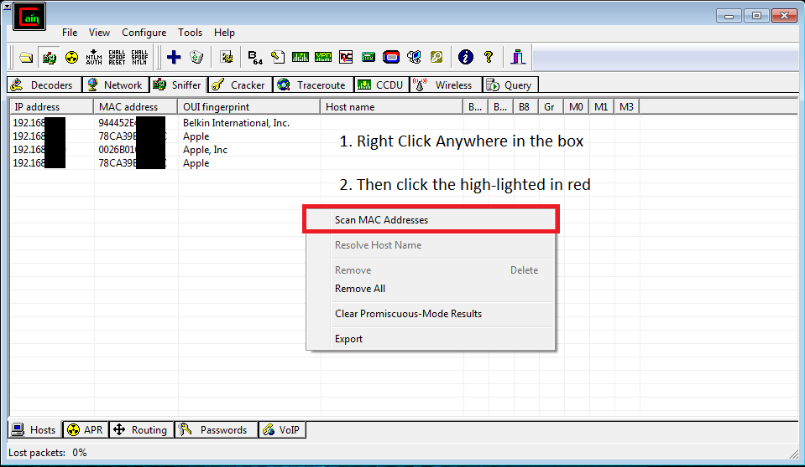
Cain and Abel Sniffers Tab

Slide 46
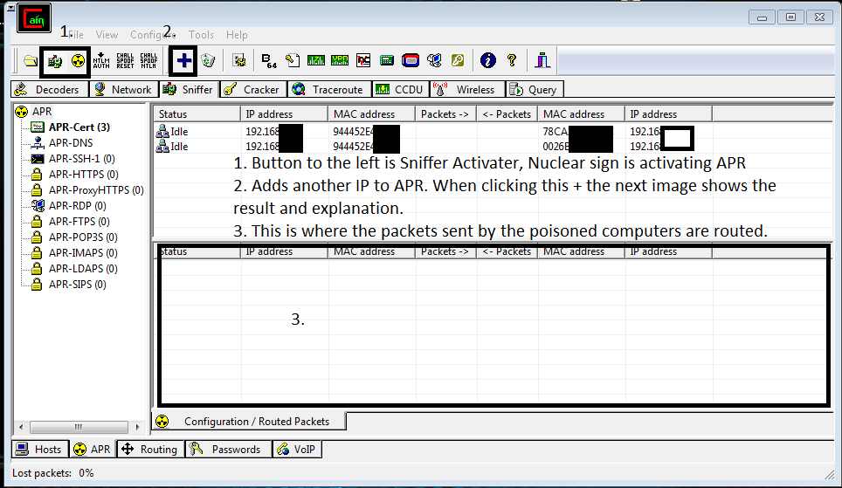
Cain and Abel APR

Slide 47
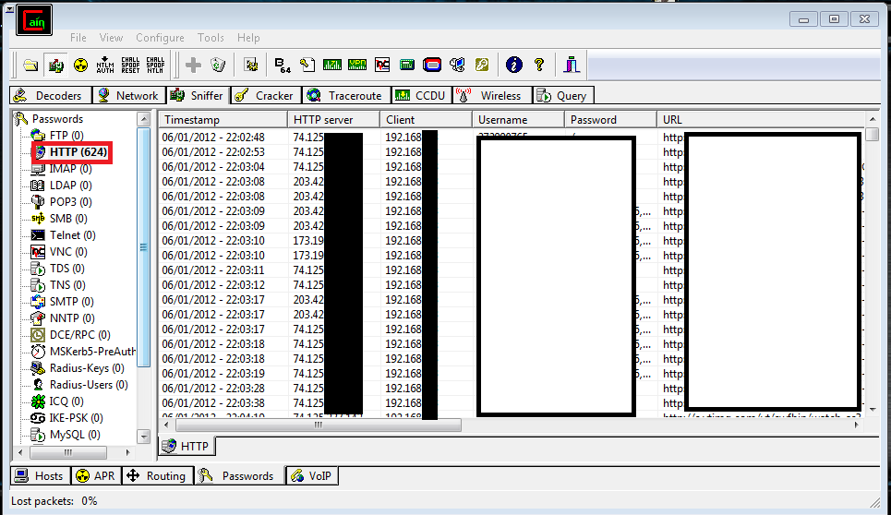
Cain and Abel Passwords Tab

Slide 48
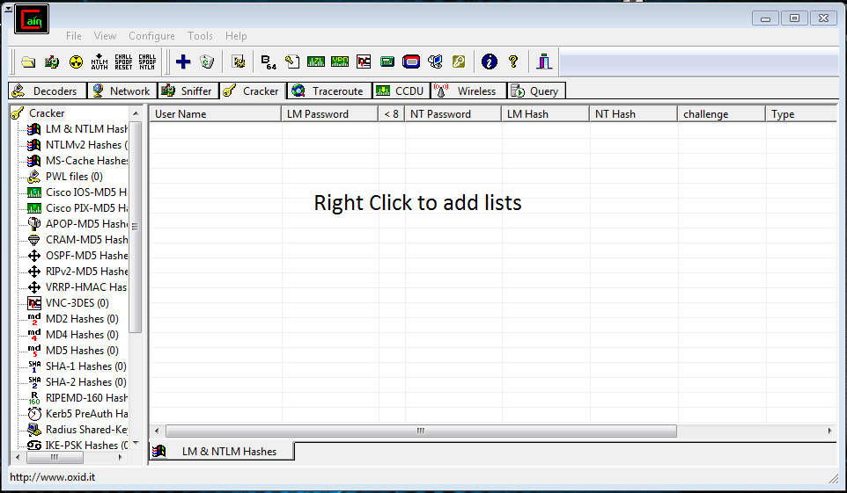
Cain and Abel Cracker Tab

Slide 49
Exfiltration Tools
These are used to exfiltrate data using steganography or encryption to disguise the data, to make use of common protocols that are normally allowed to leave the environment, or to use out of band methods.

Slide 50
Physical Exfiltration
Physical removal of data is one of the methods most proof against detection.
The shrinking size of storage media makes such methods even more easily hidden on a person or in equipment.
Given the ability to store large amounts of data in a very small package, items to be exfiltrated could be secreted nearly anywhere and are beyond the reasonable realm of detection.

Slide 51
Encryption and Steganography
Various tools exist for hiding data in formats that are not immediately visible to casual search, or in some cases, even to exhaustive search.
Certain encryption tools, eg.,
TrueCrypth, can create encrypted volumes on storage media which appear to be random noise on the media and are neither detectable nor recoverable without the proper keys or passwords.
Steganography tools such as OpenPuffi or OutGuessj can make secreting such data in digital files a relatively simple task.
Once hidden in such a file, our data can be exfiltrated by placing an image on an externally facing web server, in a background graphic or logo attached to an email.

Slide 52
Sustainment Tools
These are used to sustain the access to the system or network for a long time without being detected.
Some of the ways are:
Adding “Authorized” Access
Backdoors

Slide 53
Assault Tools
The tools that can be used to assault a compromised machine are many and varied.
They can take the form of simple changes:
to configurations or environment variables on a system.
to purpose-built botnets that can conduct a concentrated Denial of Service (DoS) attack on a given system or environment.
Such tools of destruction can generally be categorized into those related to software or oriented on hardware.

Slide 54
Ettercap
Ettercap stands for Ethernet Capture.
Ettercap is a comprehensive suite for man in the middle attacks.
It features sniffing of live connections, content filtering on the fly and many other interesting tricks.
It supports active and passive dissection of many protocols and includes many features for network and host analysis.

Slide 55
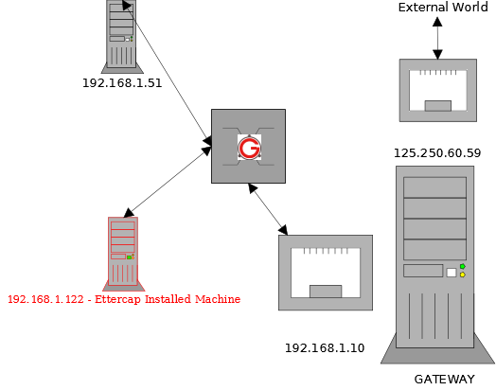
Launching an ARP Poisoning Attack

Slide 56
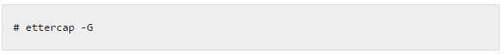
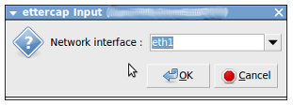
Launching an ARP Poisoning Attack
Launch Ettercap using the following command in the 122 machine:
Click “Sniff->Unified Sniffing”. It will list the available network interface as shown below. Choose the one which you want to use for ARP Poisoning.

Slide 57
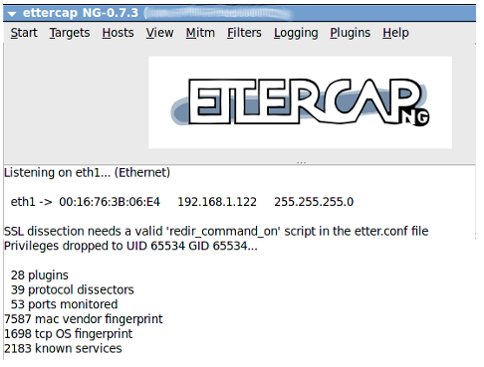
Launching an ARP Poisoning Attack
Once you have chosen the interface the following window will open:
The next step is to add the target list for performing the ARP poisoning.
Click “Hosts->Scan for Host”.
It will start to scan the hosts present in the network.

Slide 58
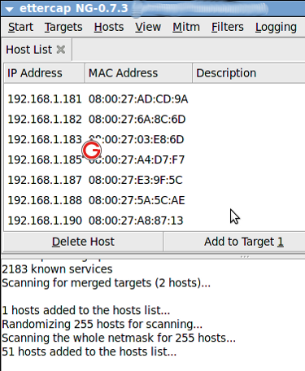
Launching an ARP Poisoning Attack
Once it is completed, click “Hosts->Host List”. It will list the available hosts in the LAN as follows:

Slide 59
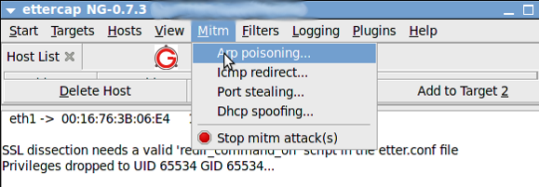
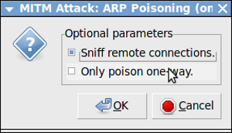
Launching an ARP Poisoning Attack
Now select “Mitm->Arp Poisoning” as follows:
The following dialog box will open. Select “Sniff Remote Connection” and click “ok”:

Slide 60
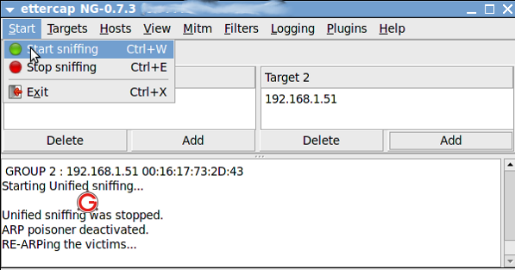
Launching an ARP Poisoning Attack
Click “Start->Start Sniffing as follows:

Slide 61
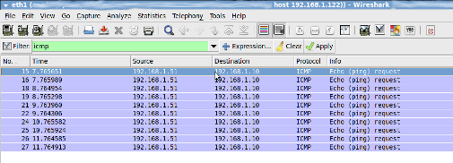
Launching an ARP Poisoning Attack
Now Arp is poisoned, i.e, 122 machine starts to send ARP packets saying “I’m 1.10”. In-order to verify it, From 192.168.1.51 “ping 192.168.1.10”. Open “Wireshark” application in 192.168.1.122 machine, and put a filter for ICMP. You will get the ICMP packets from 192.168.1.51 to 192.168.1.10 in 192.168.1.122 as follows:

Slide 62
Obfuscation Tools
To obfuscate means to “confuse, bewilder, or stupefy”; “to make obscure or unclear”.
These set of tools are used to cover the tracks when operating on a system or in an environment.
There are three main types of tasks that we are concerned with in such cases:
Location Obscuration
Log Manipulation
File Manipulation

Slide 63
References
[1] | J. Andress and S. Winterfeld, Cyber warfare: Techniques, tactics and tools for security practitioners. Waltham, MA, USA: Syngress / Elsevier, Inc., 2011.
[2] | R. C. Parks and D. P. Duggan, “Principles of cyber-warfare,” Proceedings of the IEEE Workshop on Information Assurance and Security, pp. 122–125, June 2001.
[3] | DC214, “Top 100 Network Security Tools”, Available at: www.dc214.org/notes/sectools.ppt, Last accessed: September 2016.
[4] | Cyberwarzone, “Cyber Security tools list 2014”, Available at: http://cyberwarzone.com/cyber-security-tools-list-2014/, Last accessed: September 2016.

